Slide 1
CAPSTONE PROJECT
Sauce Demo
Automation testing
Project
Java Selenium Batch 3
Guided By : Vishal Gupta
Submitted By : Bhavana Bommineni

Slide 2
Content :
Project overview
Features
Requirements
Work Flow
Modules implemented
Test Execution & Reports
Future Enhancements
Dependencies
Test cases Screenshots
Agile Board - Zephyr
Conclusion
References & links

Slide 3
Project overview
This project automates testing of the SauceDemo.com website using Java, Selenium WebDriver, and TestNG.
It validates key user flows like login, logout, add to cart, checkout, sorting, and error handling.
Test results are captured in Allure and Surefire Reports to ensure smooth website functionality under different scenarios.
The goal of this project is to ensure smooth website functionality by automating workflows and validating behaviour across scenarios

Slide 4
Features
Login Test – Valid and invalid login verification
Add to Cart – Add/remove products functionality
Checkout – Complete checkout flow with details
Sorting – Sort by name and price (a–z, z–a, low–high, high–low)
Logout – Automated logout via menu
Locked User – Validate error message for locked users
Cart Badge Count – Verify count after adding/removing products

Slide 5
Requirements
Language: Java
Automation Tool: Selenium WebDriver
Framework: TestNG
Build Tool: Maven
Reporting: Allure Reports
Version Control: GitHub

Slide 6
Work Flow
USERLOGIN
ADD TO CART
ADD DETAILS
OVERVIEW
FINISH
CHECKOUT

Slide 7
Modules Implemented
Login Functionality Testing (valid & invalid users)
Inventory Page Verification (product list & selection)
Product Information Page Testing
Shopping Cart & Checkout Process
Negative Scenarios (e.g., locked user login)

Slide 8
Test Execution & Reports
Automated scripts executed using TestNG
Test outcomes automatically tracked with Allure Framework
Allure generates clear and interactive reports
Screenshots taken for all executed test cases

Slide 9
Future Enhancements
Use Jenkins to automatically run tests whenever new code is added.
Check the website on different browsers (like Chrome, Firefox, Edge) using cloud tools.
Add more test cases to cover complicated situations.

Slide 10
Dependencies
Selenium dependencies
<dependency>
<groupId>org.seleniumhq.selenium</groupId>
<artifactId>selenium-java</artifactId>
<version>4.25.0</version>
</dependency>
TestNG dependencies
<dependency>
<groupId>org.testng</groupId>
<artifactId>testng</artifactId>
<version>7.10.2</version>
<scope>test</scope>
</dependency>

Slide 11
Allure dependencies
<dependency>
<groupId>io.qameta.allure</groupId>
<artifactId>allure-testng</artifactId>
<version>2.29.0</version>
</dependency>

Slide 12
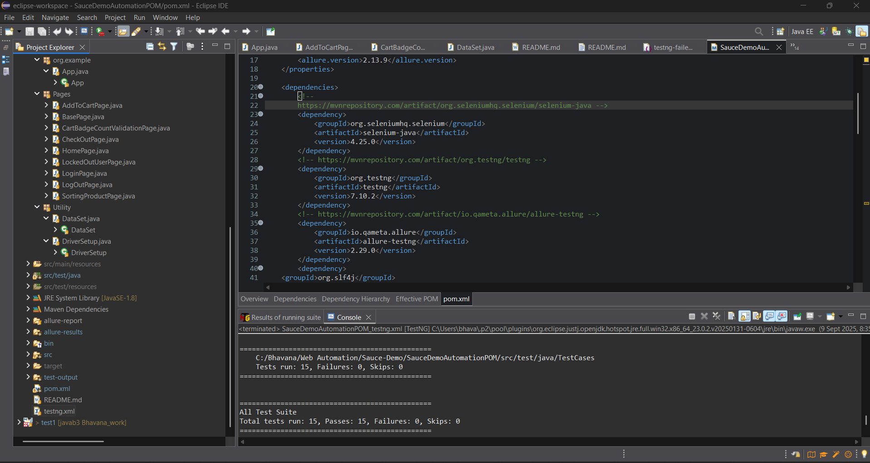
Outcome

Slide 13
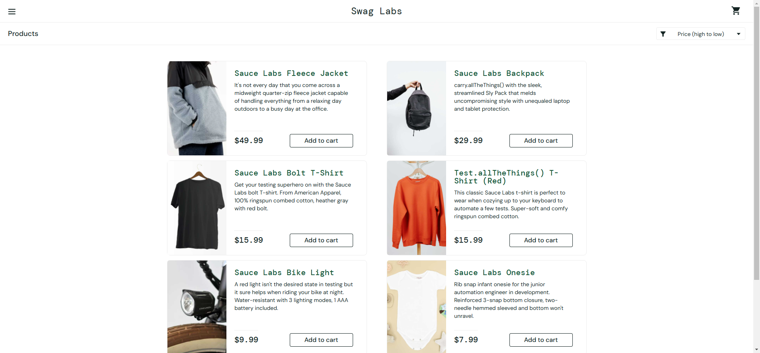
Testcases Screenshots

Slide 14
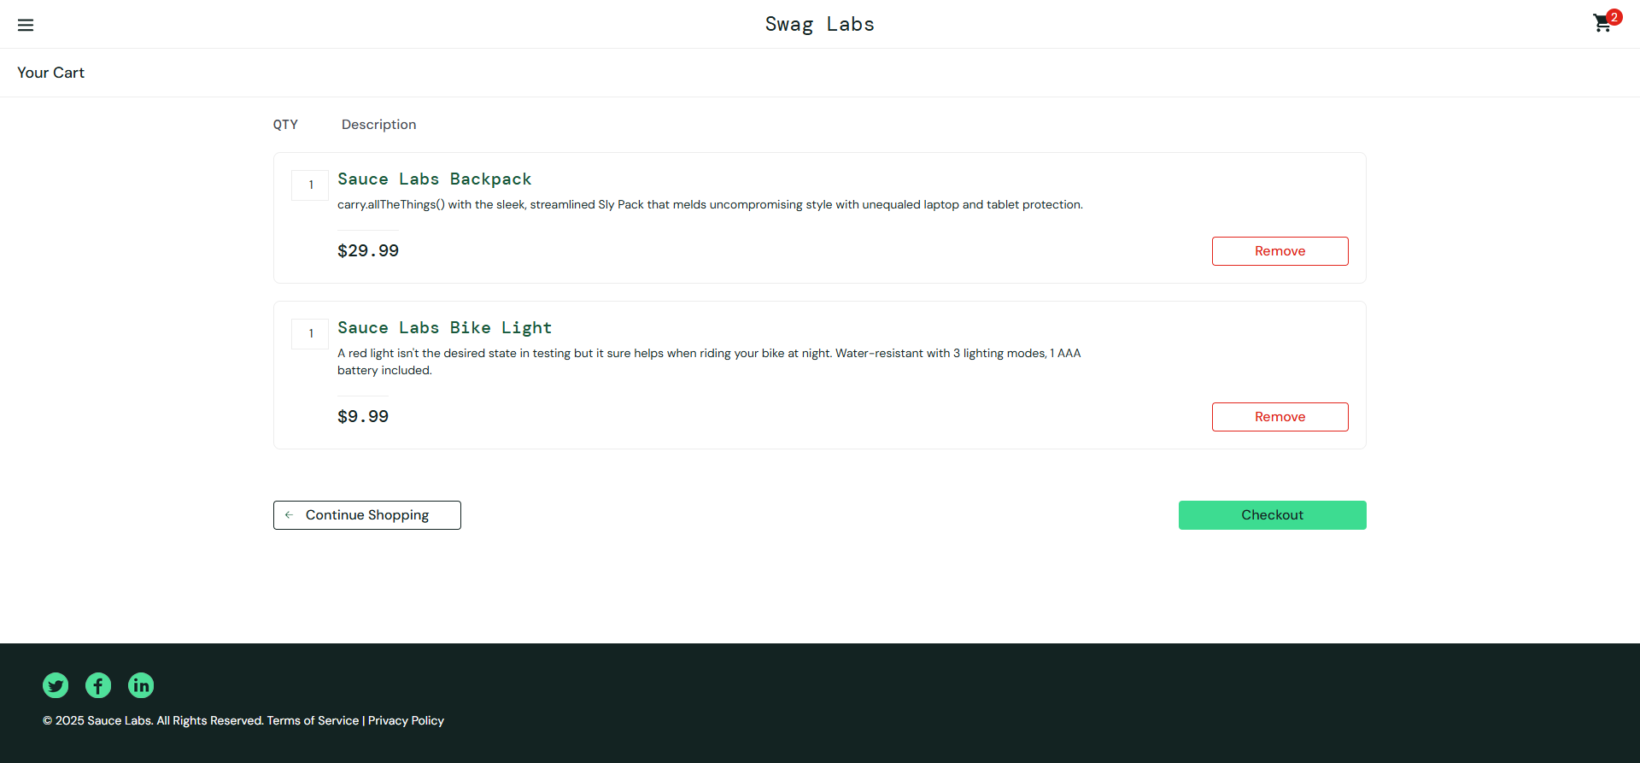

Slide 15
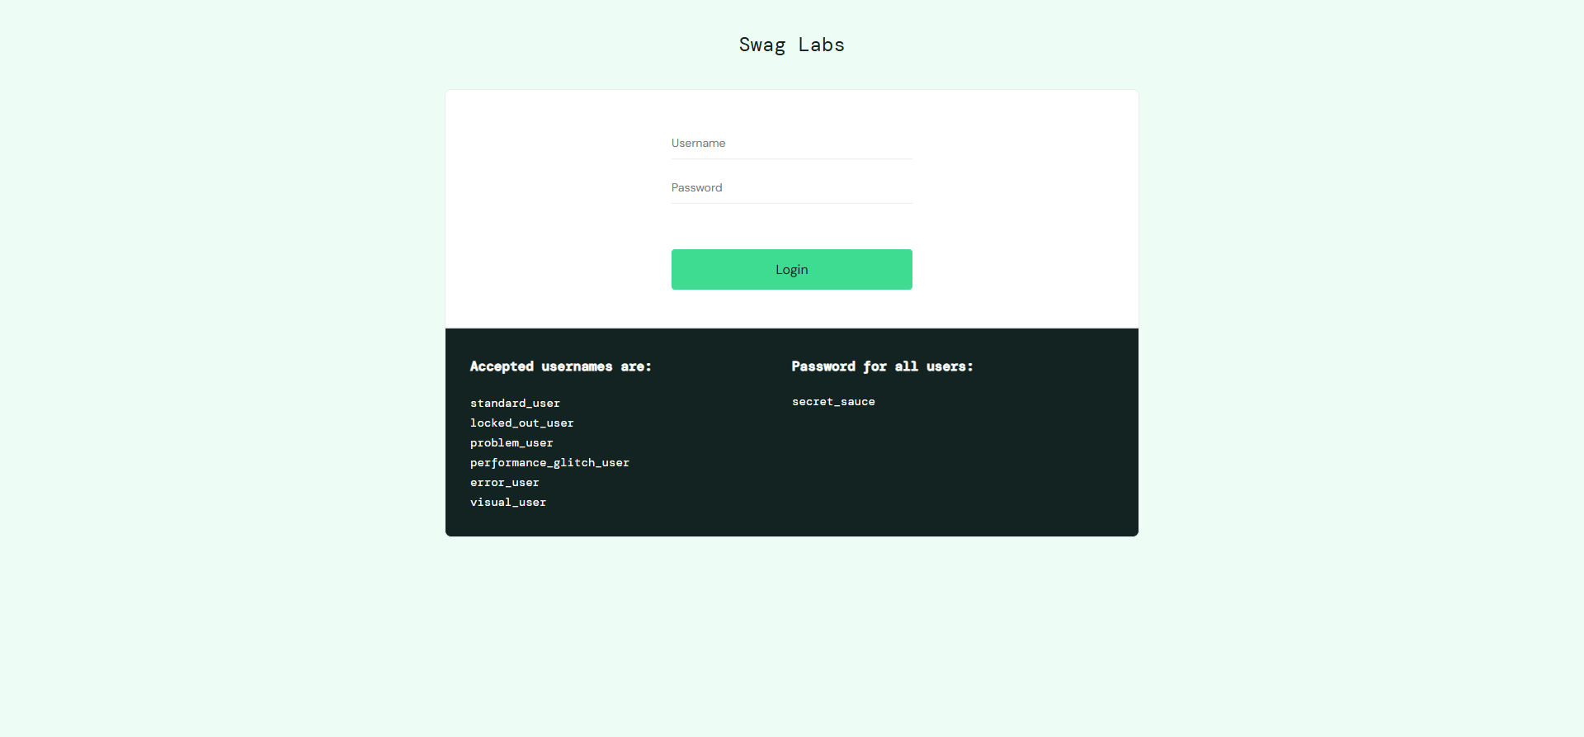

Slide 16
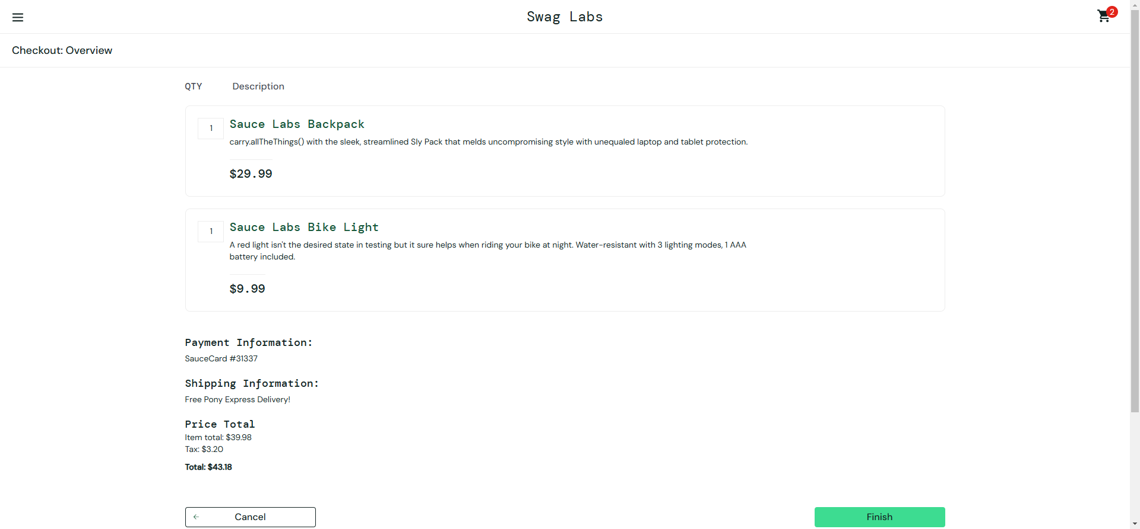

Slide 17
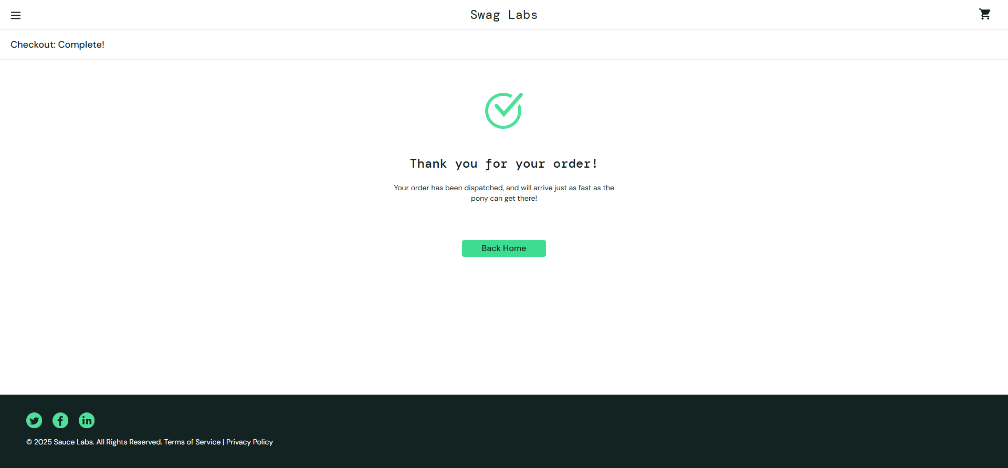

Slide 18
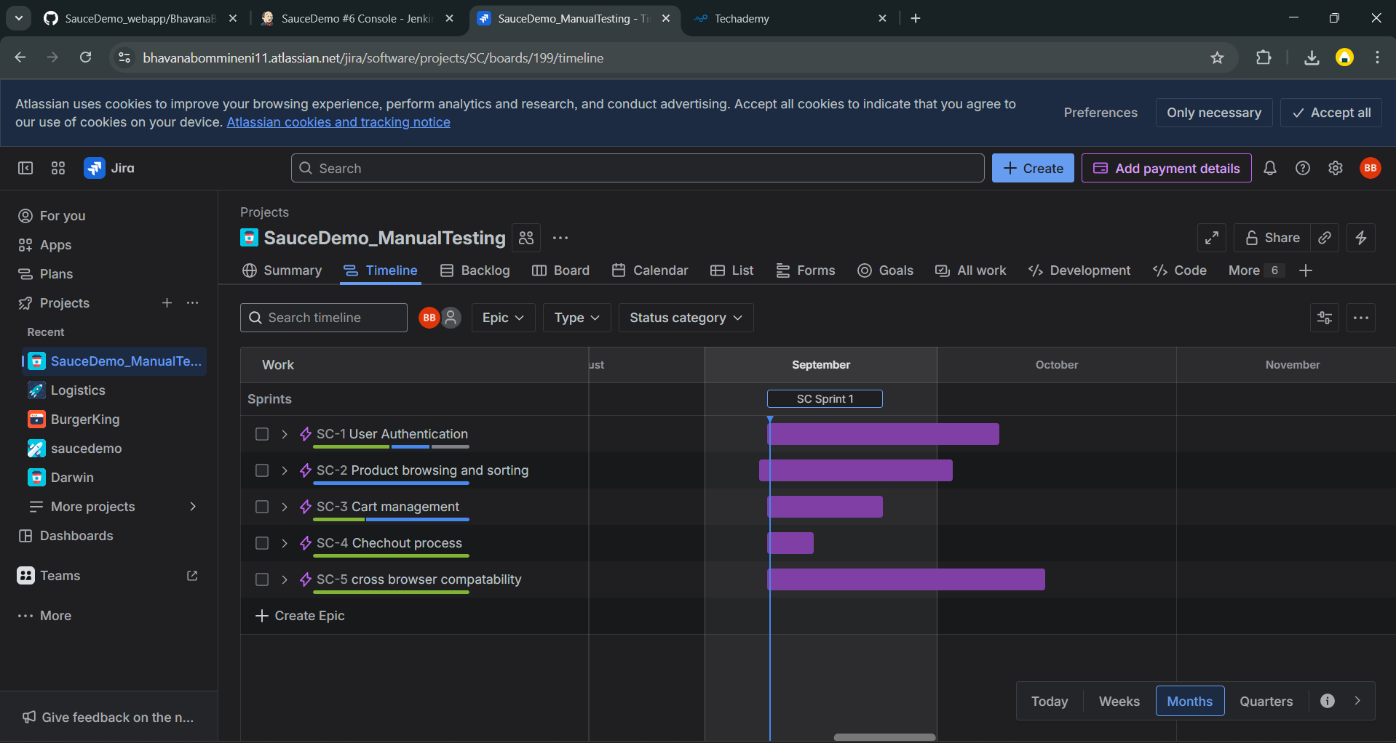
Agile Board - Zephyr

Slide 19
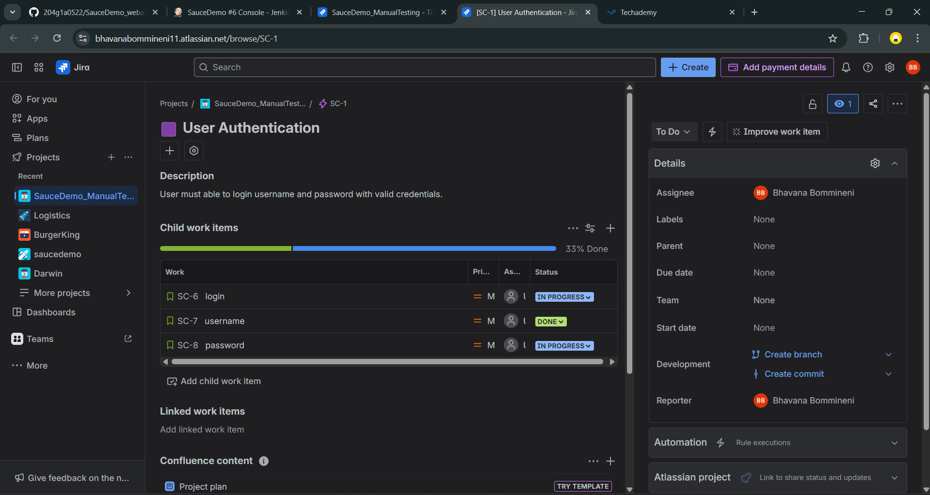

Slide 20
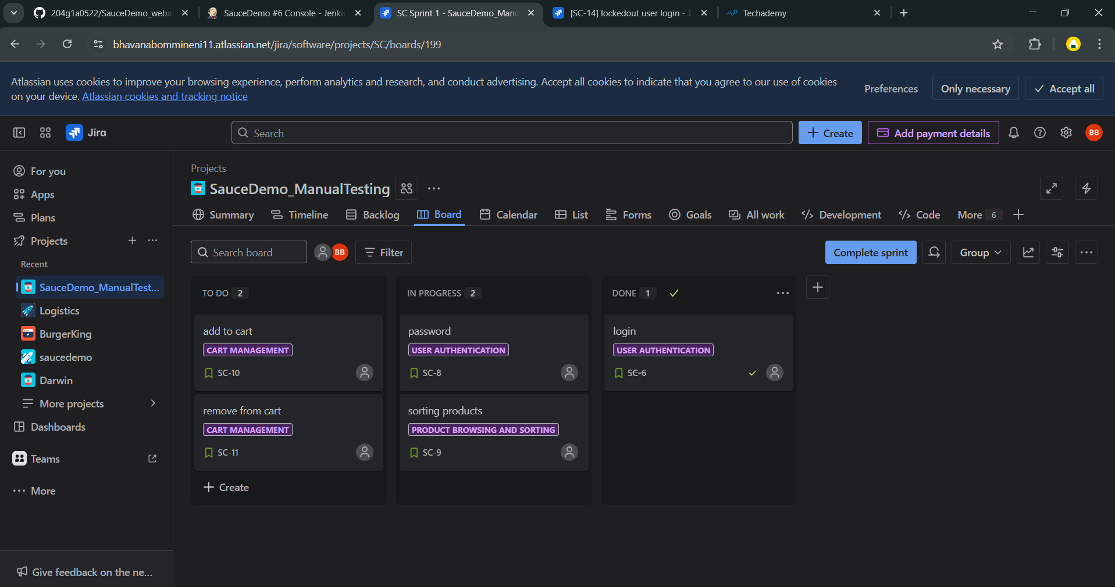

Slide 21
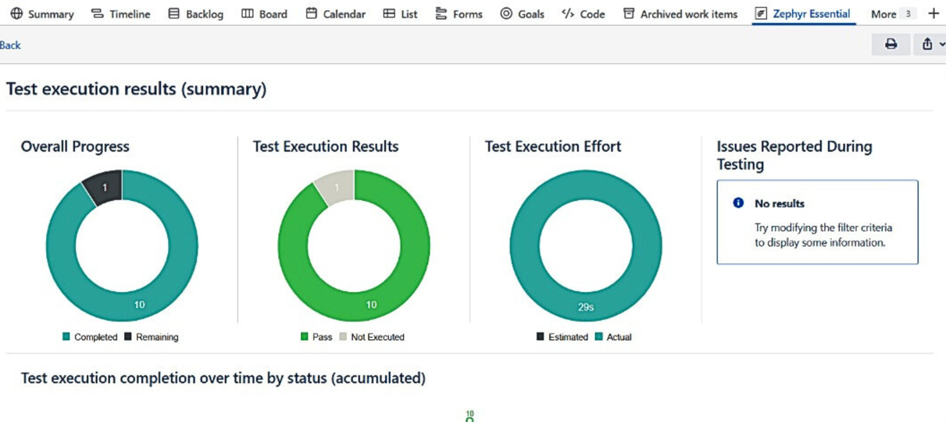
Zephyr Reports

Slide 22
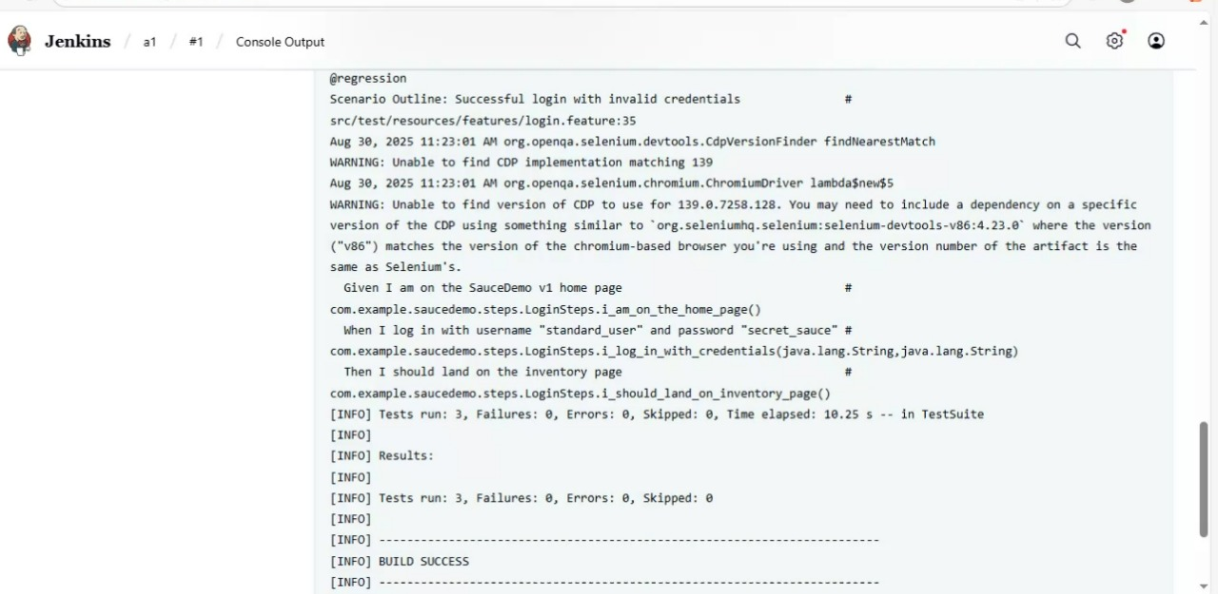
Jenkins for CI/CD

Slide 23
Conclusion
The project successfully automated the SauceDemo website.
Made the tests more efficient, reliable, and reusable.
Improved accuracy while reducing manual work.
Can be easily connected to CI/CD pipelines for real-time use.
Built a flexible framework that can grow with future needs.

Slide 24
References & Links
GitHub :
https://github.com/204g1a0522/SauceDemo_webapp.git
Website :
https://www.saucedemo.com/

Slide 25
Thank You…

